Slide 1
Making College Affordable…
One Family at a Time!

Slide 2
Most advisors talk about picking the winners.
I would rather help you avoid the losses.

Slide 3
https://cssprofile.collegeboard.org

Slide 5
Sign in to complete your CSS Profile
If you are applying for Fall 2018 or Spring 2019 select 2018-19.
Sign In 2018-19
If you are applying for Fall 2017 or Spring 2018 select 2017-18.
Sign In 2017-18

Slide 6
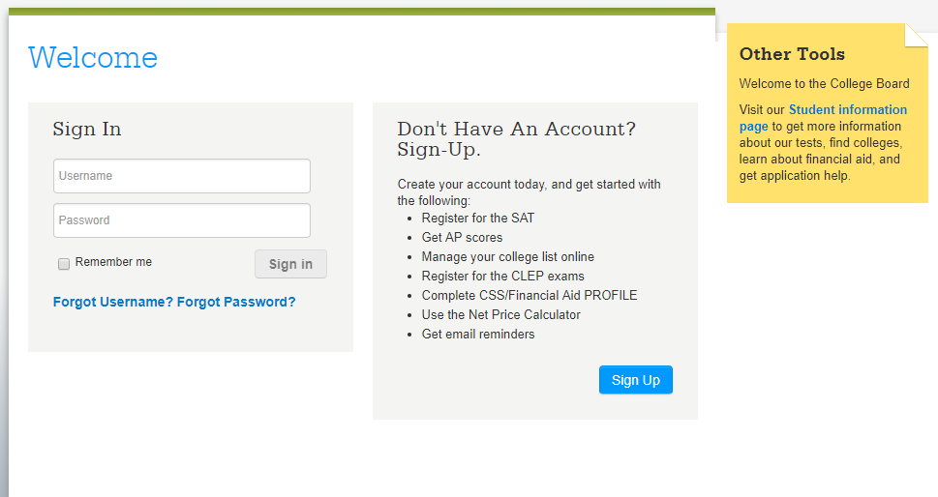

Slide 7
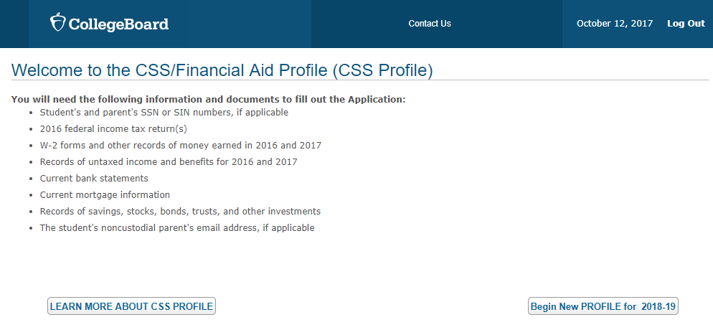

Slide 8
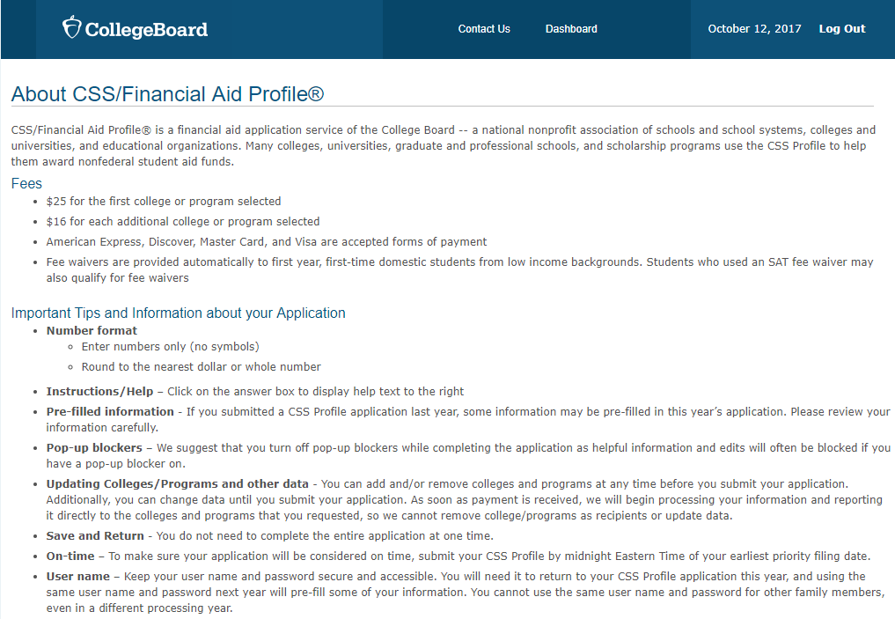

Slide 10
https://profile.collegeboard.org/profile/ppi/participatingInstitutions.aspx
PROFILE hotline for families: 1-844-202-0524

Slide 11
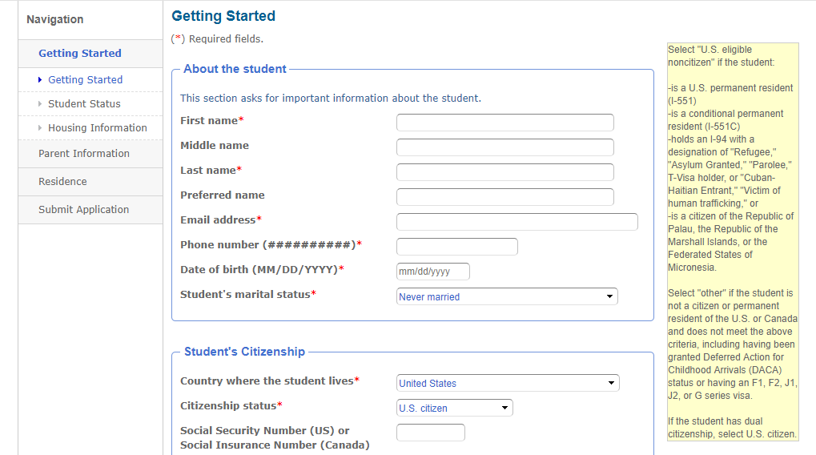

Slide 12
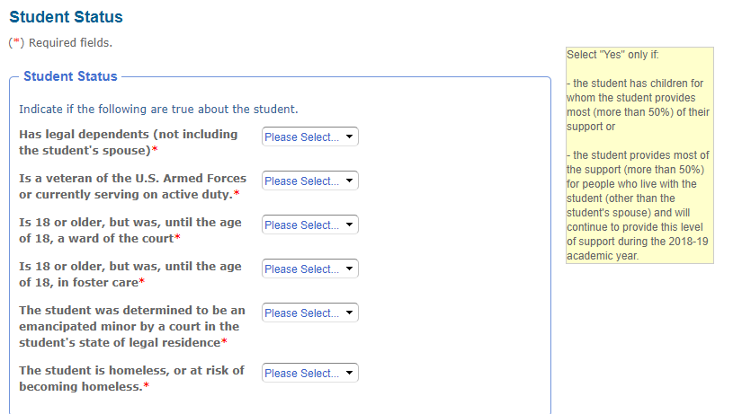

Slide 13
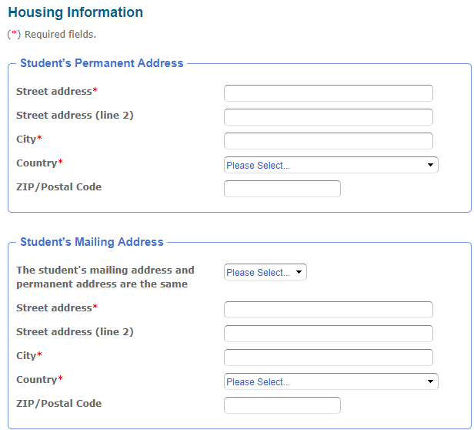

Slide 14
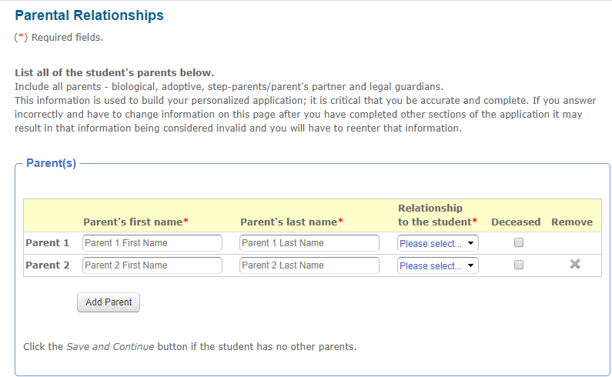

Slide 15
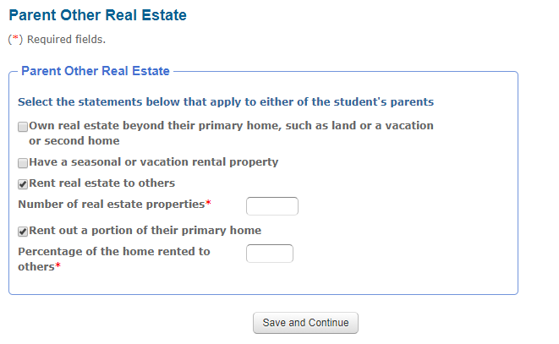

Slide 17
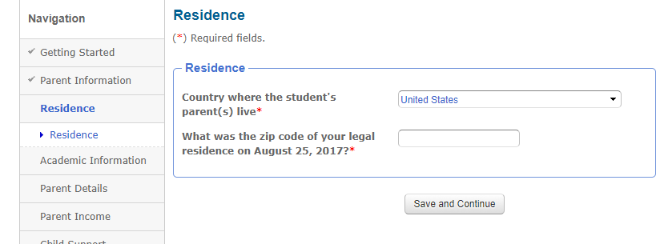

Slide 18
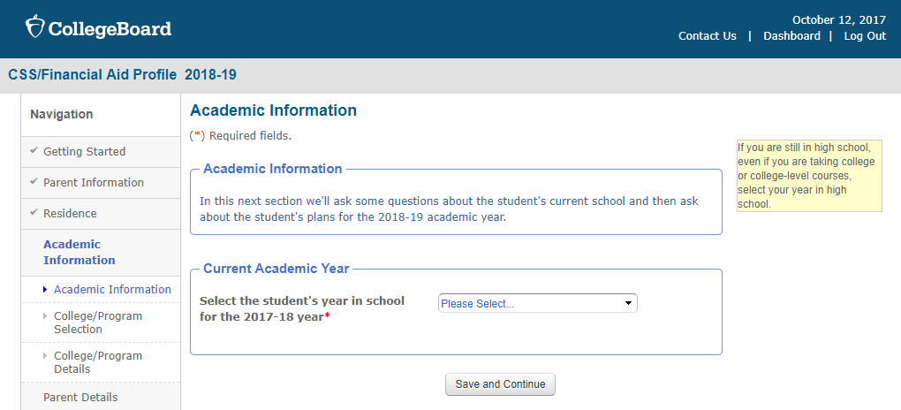

Slide 19
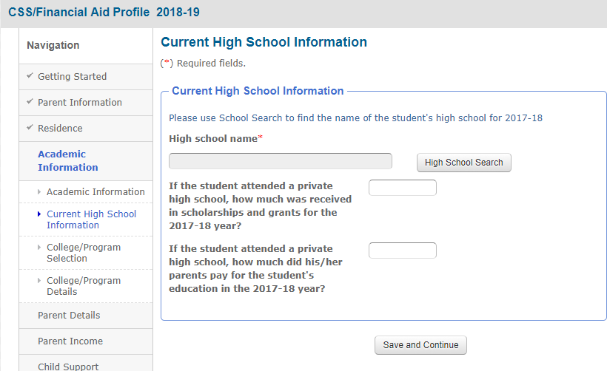

Slide 20
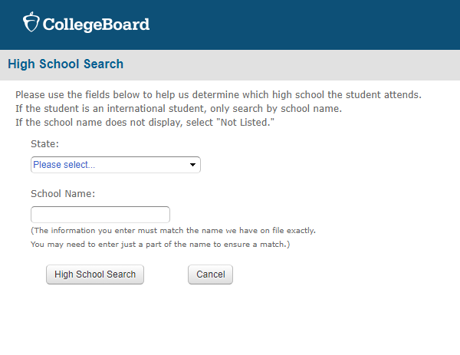

Slide 21
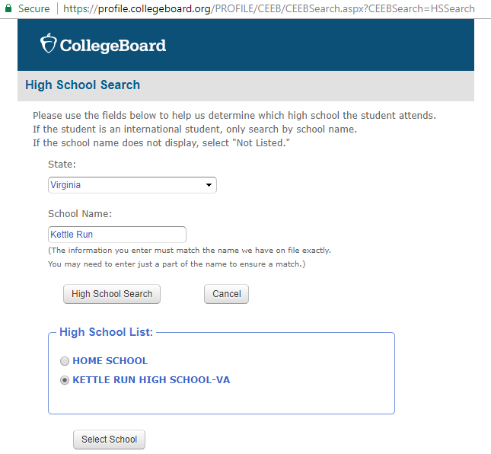

Slide 22
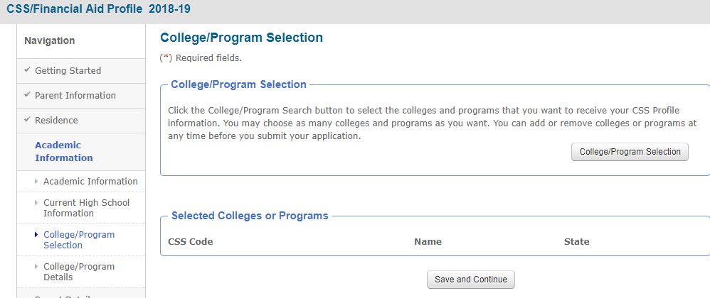

Slide 23
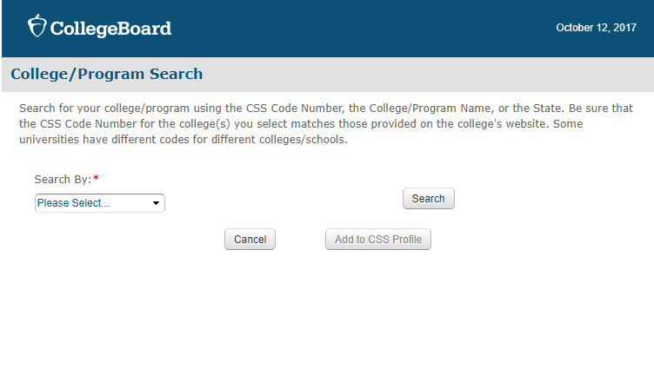

Slide 24
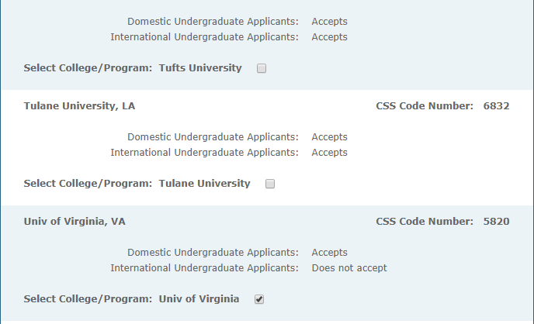

Slide 25
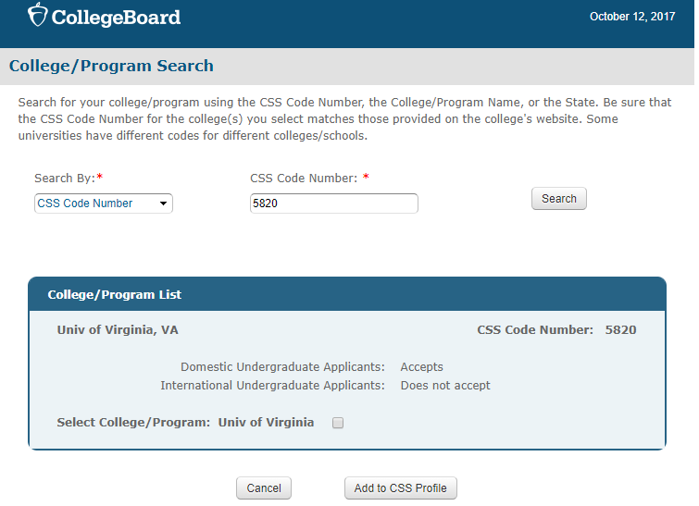

Slide 26
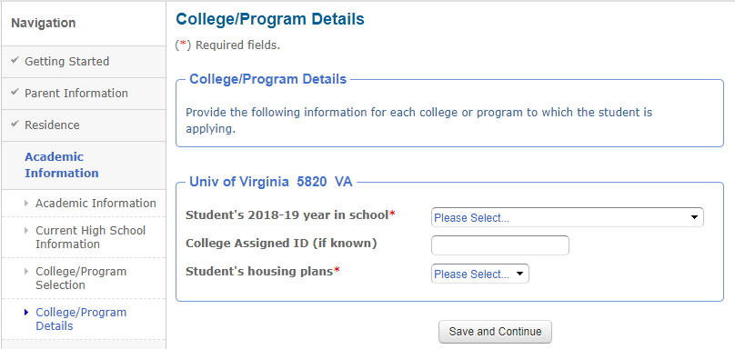

Slide 27
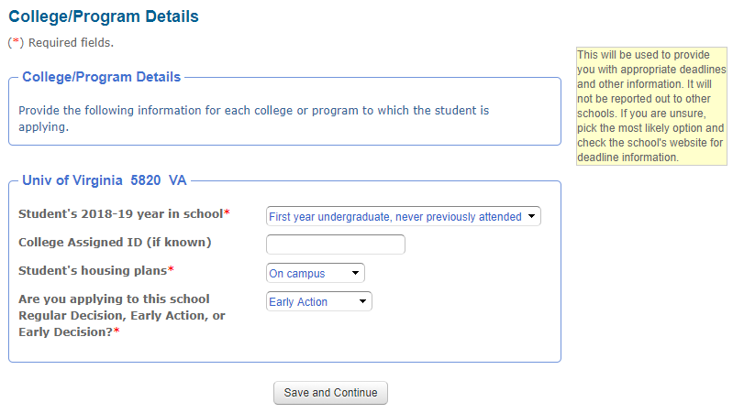

Slide 28
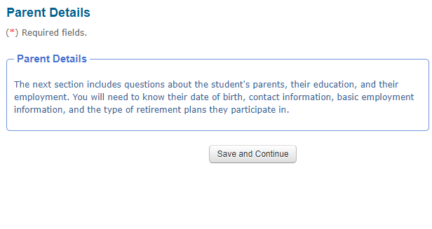

Slide 33
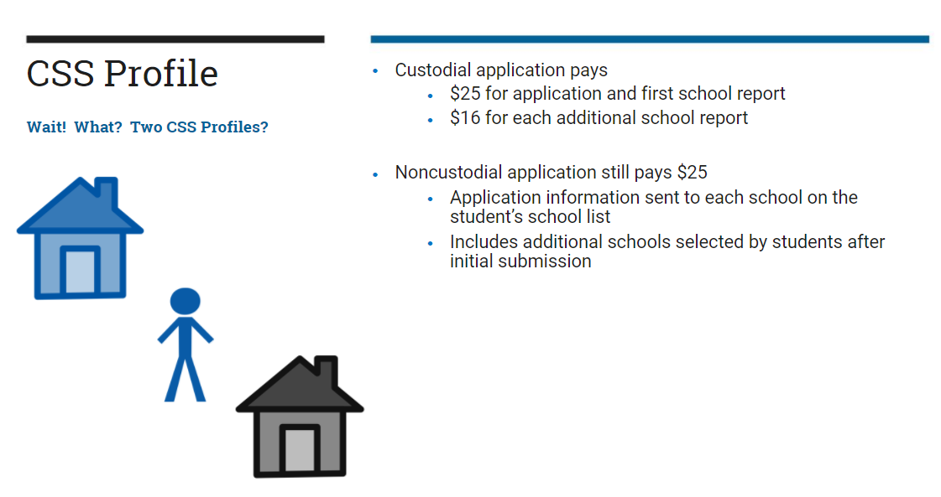

Slide 34
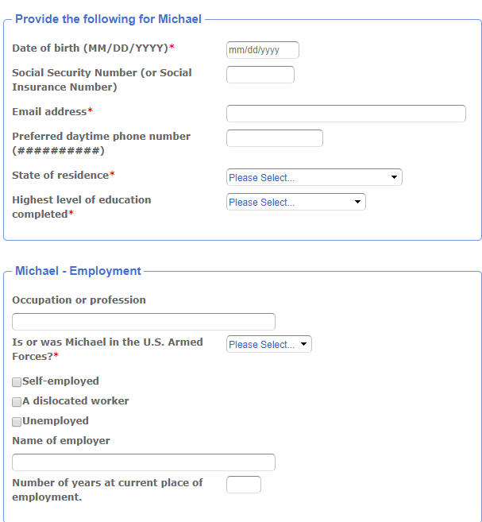

Slide 35
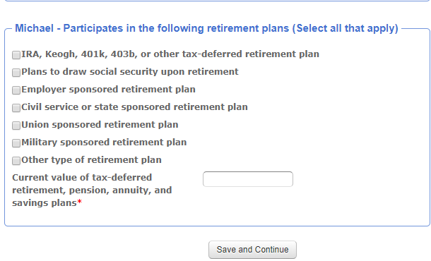

Slide 36
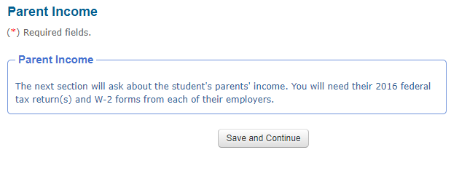

Slide 37
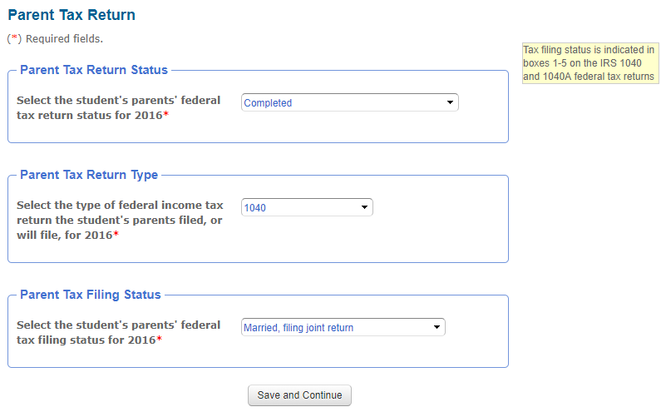
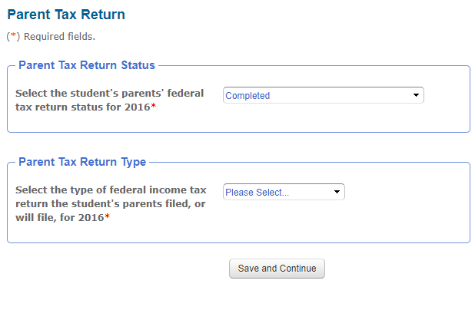

Slide 38
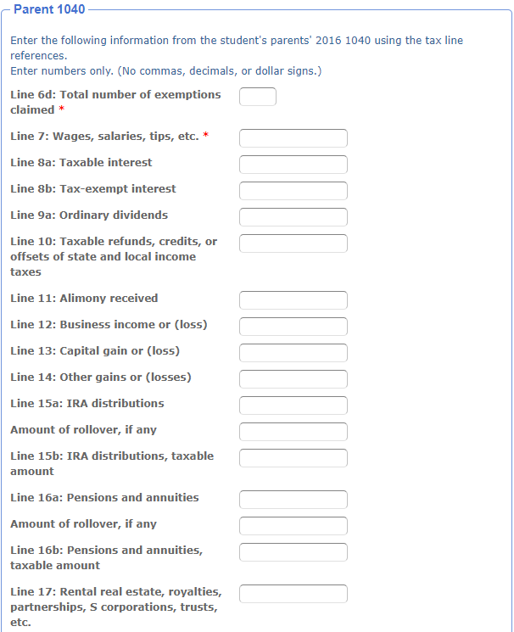

Slide 39
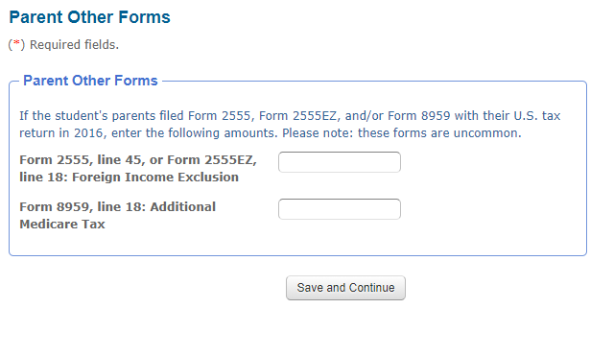

Slide 40
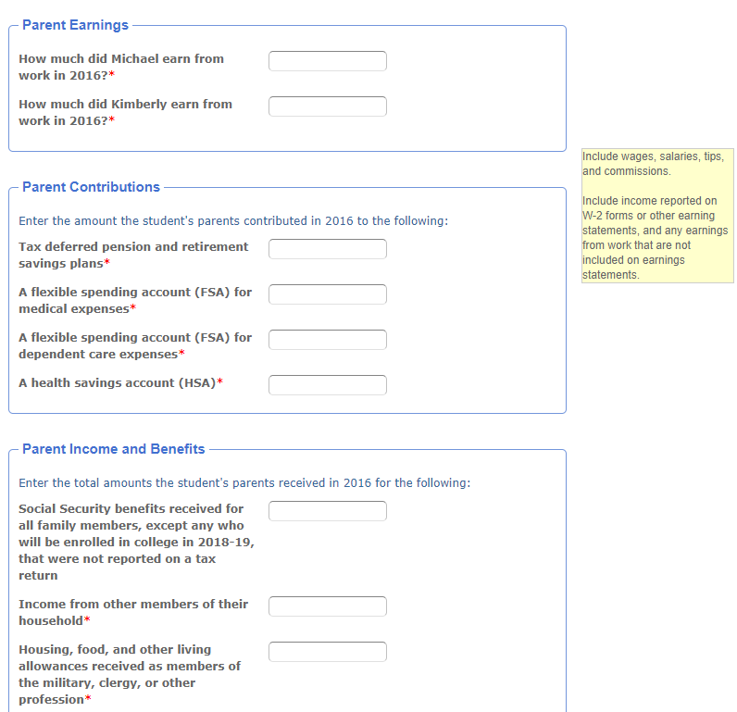

Slide 41
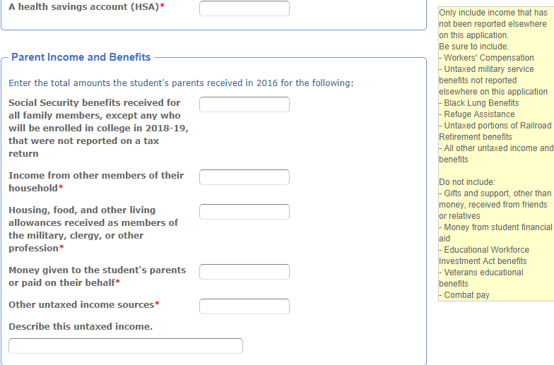

Slide 42
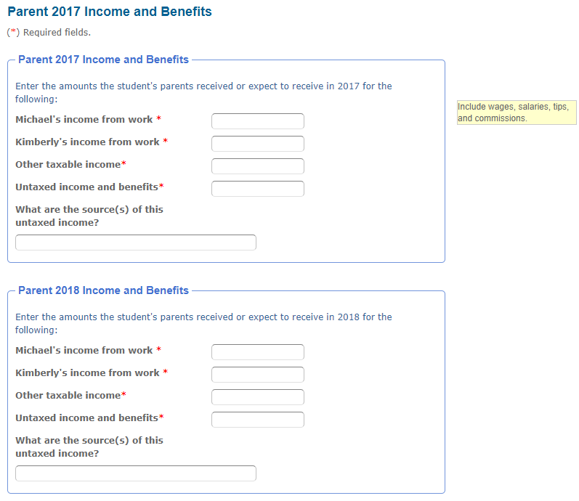

Slide 43
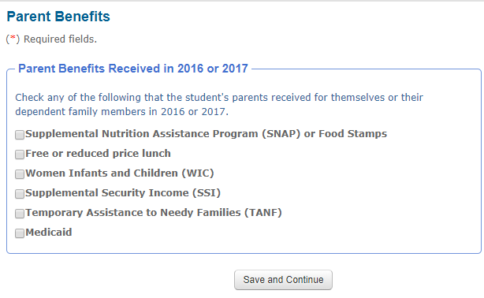

Slide 44
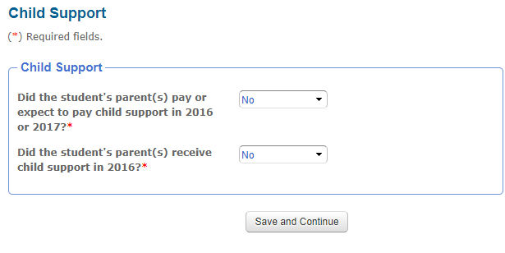

Slide 45
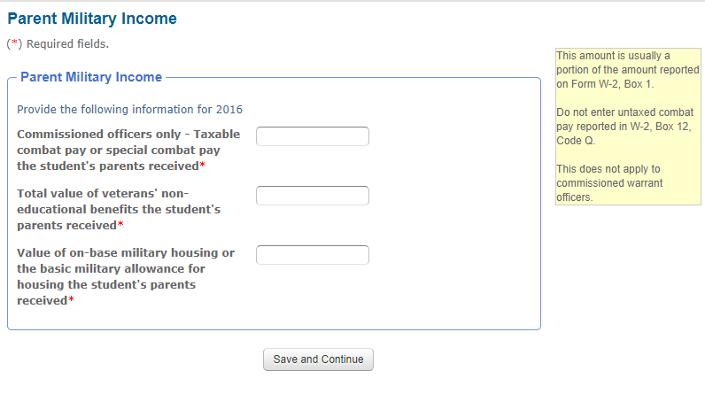

Slide 46
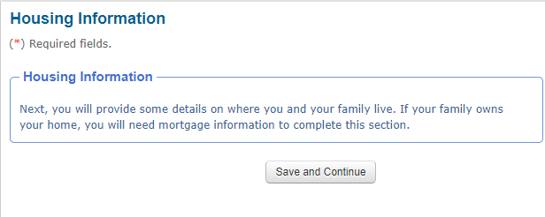

Slide 48
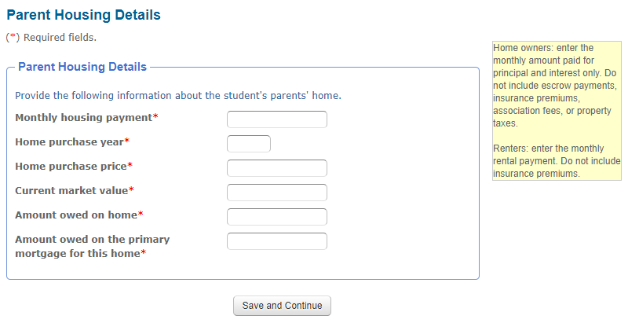

Slide 49
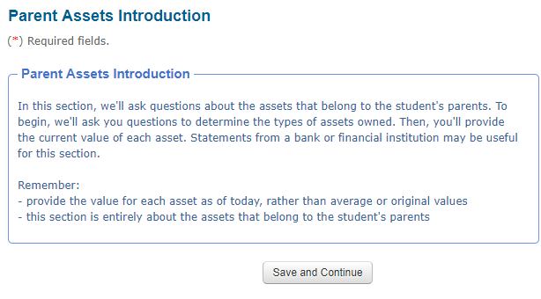

Slide 50
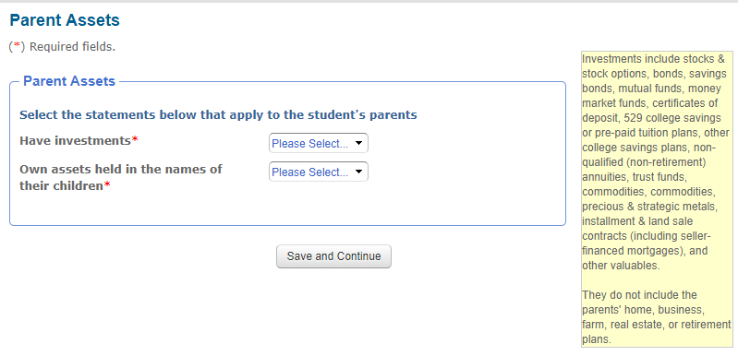

Slide 51
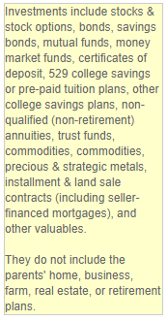

Slide 52
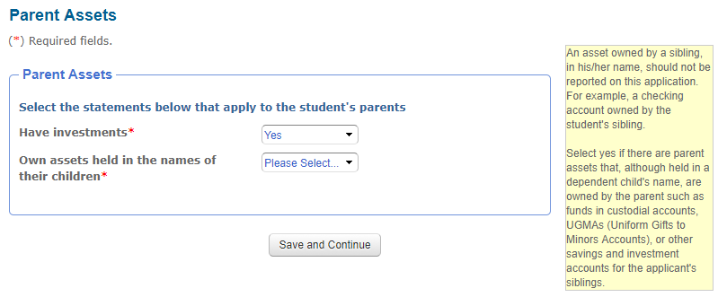

Slide 53
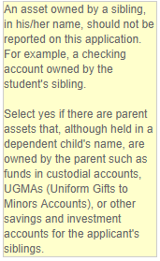

Slide 54
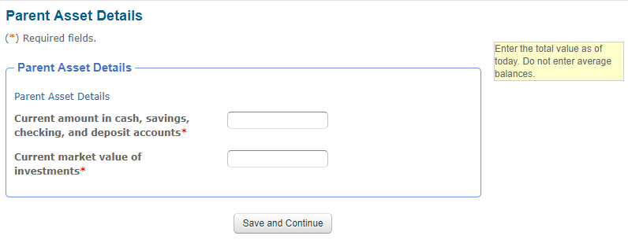

Slide 55
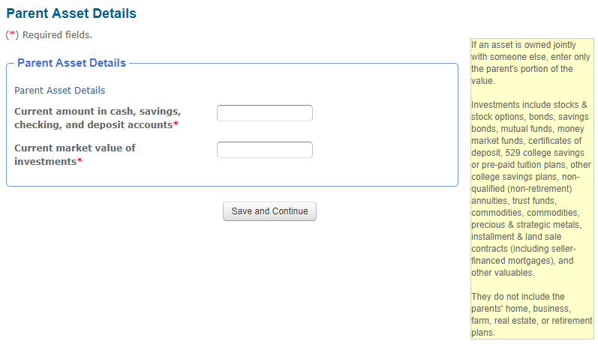

Slide 56
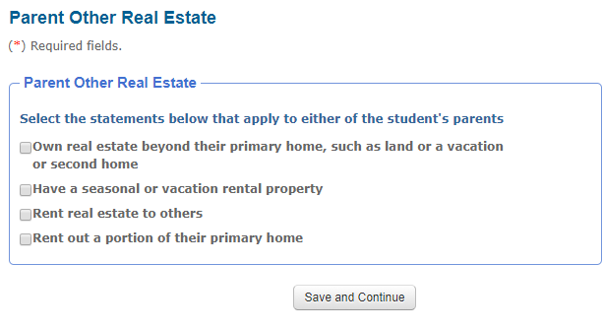

Slide 57
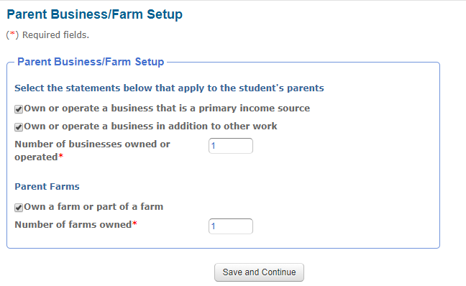

Slide 58
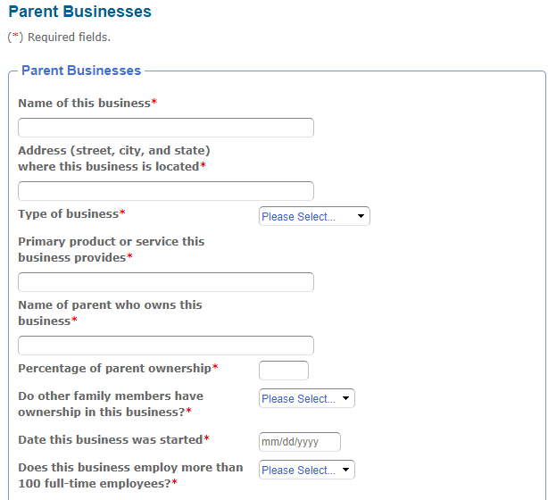

Slide 59
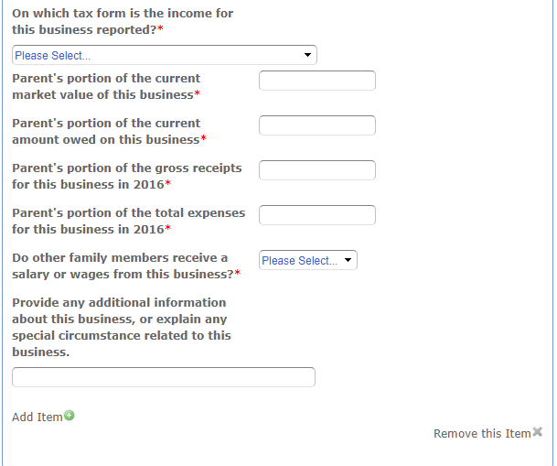

Slide 60
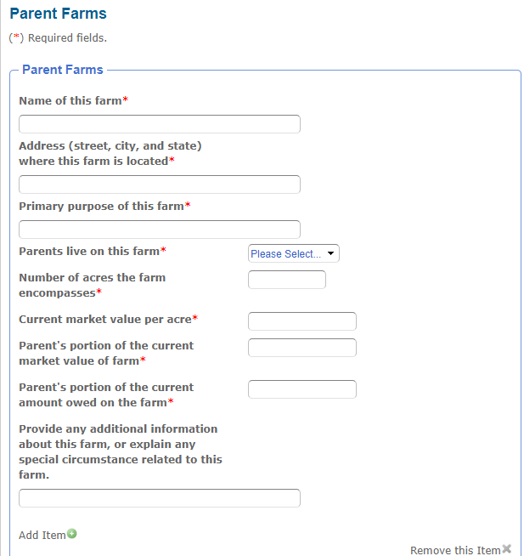

Slide 61
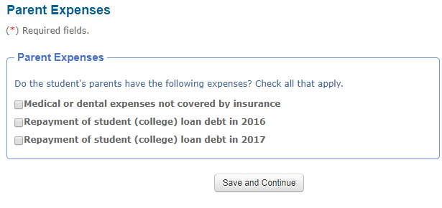

Slide 63
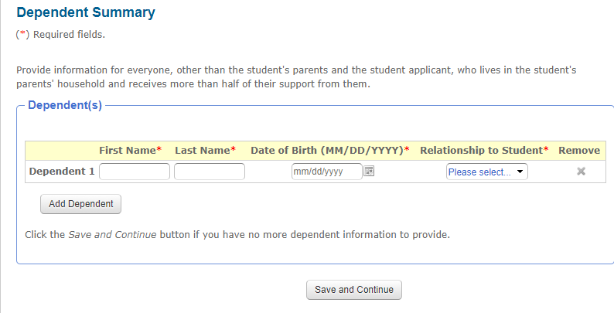

Slide 81
https://cssprofile.collegeboard.org/pdf/css-profile-waiver-request-non-custodial-parent.pdf

Slide 83
International Applicants
Many colleges provide institutional financial aid to international students.
View our list of participating colleges to see if the CSS Profile is required to apply for institutional financial aid.
Our software service platform is located in the United States. Your information will be transferred from your location to the United States. When you furnish information to the College Board through this system, you are consenting to a cross-border transfer of information. If you choose not to provide your information please notify the college(s) requesting your application.

Slide 84
Would you please be certain to address the information requirements for small business owners who own real estate as part of that business? My husband has an LLC that owns and manages three small pieces of real estate.
We are struggling with how to complete the business/investment/real estate section. We own minority interests in various commercial real estate buildings and land, and residential development land. These are all owned through LLCs. We are not sure if or how to list those.
1) where do we report cash out refinance money on the CSS? 2) do we have to report a LLC small business checking account and where to place the dollar amount (line item) 3) where do we report a 414h EE pension amount part of the NYC teachers retirement system?

Slide 85
Regarding the CSS question asking for the "total value of parent assets held in the name of their children," do I list the total of CD's my husband owns as custodian (under a CUTMA) for each of our kids? Is the CD on which my son is the beneficiary *also* listed as *my son's* investment in the student portion of the form? I am self employed. My income is listed on my tax return on Schedule C-EZ as "Net profit from business" (Sole Proprietorship.) Obviously, I note this income on the CSS where it asks for "Parent's portion of the gross receipts for this business," but do I *also* include it in the "Parent Earnings" section of the CSS where it asks for the amount I "earn[ed] from work?"

Slide 86
There is a questions that asks if you plan to draw ss upon retirement... I presume this is a yes... Why wouldn't someone do that...?
2. Asks for value of tax deferred retirement, pension, annuity and savings plan; does this include SEP plans? (And why are they asking for this? Does this count towards assets?)
3. All info asking for income and no benefits for 2017 & 2018; My husband and I are employed ; he works in real estate and I work in fitness industry; our incomes vary from year to year as do our expenses. How can we possibly estimate this?
4. Is a SEP plan a tax deferred pension?
5. are co-pays, co-insurance, dental expenses over and above plans maximum annual coverage amount, contact lenses, eye glasses all considered medical and dental expenses not covered by insurance?
6. How can we estimate 2017 medical and dental expenses? Do we/can use 2016 numbers?
7. Under income and benefits it asks for other untaxed income sources; would we would income withdrawal we made from SEP plan here? And what if this was a one off withdrawal due to lack of income over a short period of time... Do they care ?

Slide 87
8. Will either parent receive W-2 ? How would I know for upcoming year...?
9. Asking for sibling info for 2018-2019... I have twin daughters. We dont know the college the other will attend yet nor the cost...
10. Total educational expenses paid or expected to be paid by students parents in 2018-2019.. We have 529 money for each child but not enough to cover all 4 years... How do we answer this?
11. Special circumstances: exceptional medical expenses- not for this year but previous years and upcoming years we've have to pay insane insurance premiums as self employed individuals...would this be special circumstances ? What about all co-insurnace costs, co-pays etc. this adds up to a lot of money for us each year.
How does one document eldercare expenses?

Slide 88
The Profile asks the custodial parent in a divorce situation to answer “What the additional parent’s expected contributions are going to be” . In this case the mother is much more affluent than the father so the father (a preacher) filled out the FAFSA. He is now asking the mother how he should answer this question? Essentially what will she contribute.
There is no court-ordered agreement in this case as they have just worked out issues as they have arisen. They are very amicable. They also have a very autistic son so in the past the mother had paid for private education to the tune of about $50,000 per year though that has since stopped. I know they have 529 for the college bound student but I don’t know the amount.
How do you think she should answer this question of what her expected contributions will be??

Slide 89
1. Can you please in your workshop also talk about CSS from an international student perspective-- for those people who are not in the USA and earn in a different currency
2. Will you have to supply information about the value of your home? Like a deed or proof?
3. Will you have to supply a letter from the bank to confirm the amount that you have said you have in savings?
4. Will you have to send copies of your tax statements?

Slide 90
Husband's employer became an employee owned company several years ago. Each employee was given stock in the company (fully vested) as part of an employee stock ownership plan. From what I've been told, these are NOT stock options (they cannot buy more) - the company can choose to give more to employees if it's a profitable year. He's also been included in a management incentive plan that includes shares of employer stock, which he is NOT vested in until 10 years participation (he's 3-4 years in). Do we include ANY of this in the assets portion of the CSS? Best way to establish value of your home - finaid.org web calculator reflects 2006 data... would a real estate agent's CMA be a good idea?

